Slide 1

Tutorial 1
HTML
2017
Notes:
NOTE:
Used Content from: https://websitesetup.org/html-tutorial-beginners/

Slide 2

HTML Versions
First, a quick rundown of all the HTML versions since HTML was invented.
HTML 1.0: This was the barebones version of HTML and the very first release of the language.
HTML 2.0: This version was introduced in 1995 and it gradually evolved to allow extra capabilities including: form-based file upload, tables, client-side image maps and internationalization.
HTML 3.2: In an attempt to ensure development of standards for the World Wide Web, the World Wide Web Consortium (W3C) was founded by Tim Berners-Lee in 1994. By 1997, they published HTML 3.2.
HTML 4.0: Later in 1997, the W3C released HTML 4.0 — a version that adopted many browser-specific element types and attributes.
HTML 4.0 will later be reissued with minor edits in 1998.
HTML 4.01: In December 1999, HTML 4.01 was released.
XHTML: The specifications for this was introduced in 2000 and it was recommended to be used as the joint-standard with HTML 4.01. It incorporated XML to ensure code is properly written and to ensure interoperability between programming languages.
HTML5: The W3C published HTML5 as a recommendation in October 2014 and will later release HTML 5.1 in November 2016.

Slide 3
Choosing your HTML Editor
Free and Paid Editors
I am using
HTML-Kit
CoffeeCup
KompoZer
Komodo Edit
Notepad++
Bluefish
CodeLobster
Microsoft Visual Studio Enterprise 2015, 2017
Microsoft .NET Framework Version 4.7.02556

Slide 4
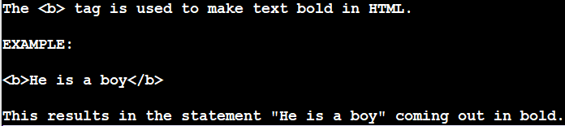
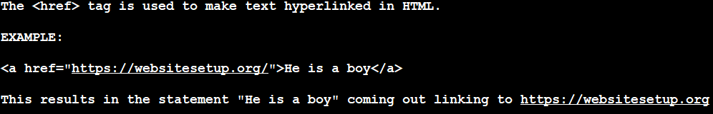
Basic Building Blocks of HTML
<tagname attribute="value">
content
</tagname>
<a href="http://www.google.com" >
Google
</a>
Tags
Attributes
Your Content +HTML +CSS = Your Website

Slide 5
Tags
Tags are practically the building block of HTML — you can’t do HTML without tags; if stuck on what tag to use, check out HTML Periodic Table
Almost every open tag must be closed. However, there are exceptions. An example of a tag that does not have to be closed is an empty tag, such as the line break: <br>.
Tags are contained in a less than (“<”) and greater than (“>”) angle bracket. Closing tags contain a trailing slash that becomes before the name of the tag being closed, though: Example of an open tag: <b>. Example of a closed tag </b>.
Every HTML file begins with the opening tag <html> and ends with the closing tag </html>. Of course, the very first line of the HTML file should declare the type of document so that the browser know what HTML flavor you use. This is why you see HTML pages start with “<!DOCTYPE html>” before the HTML code begins.

Slide 6
Attributes
The attribute is used to define the characteristics of an element, and it is used inside the opening tag of the element. Attributes are made up of a name and a value.
<p align="center">He is a boy</p>

Slide 7
<head> Element
Includes
Title
Meta data
<title>This is our page title</title>
The <meta> element specifies
information search engines can use to describe the content in their listings; this includes the description, keywords, author information, etc.
And the character set the HTML document uses.
<!DOCTYPE html>
<html>
<head>
<meta charset="utf-8">
<title>Title of your page goes here</title>
</head>
<body>
Bulk of your content here.
</body>
</html>

Slide 8
Line Breaks
<p>
Imagine there's no Heaven <br>
It's easy if you try <br>
No hell below us <br>
Above us only sky <br>
</p>
This tag does not need to be closed, since it doesn't encapsulate anything.

Slide 9
Formatting and More
<ol>
<li>Item 1</li>
<li>Item 2</li>
<li>Item 3</li>
</ol>
<ul>
<li>Item 1</li>
<li>Item 2</li>
<li>Item 3</li>
</ul>
<ul>
<li>Item 1
<ul>
<li>Item 1 nested</li>
<li>Item 2 nested</li>
<li>Item 3 nested</li>
</ul>
</li>
<li>Item 2</li>
<li>Item 3</li>
</ul>
Lists

Slide 10
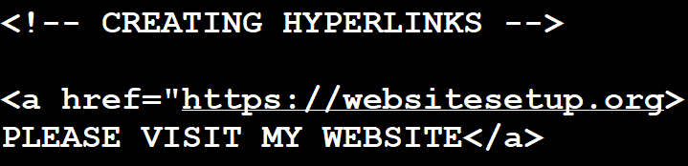
Hyperlinking
<a href=”about-page.html” target=”_blank”>YOUR LINK TEXT HERE</a> specifies that the link should be opened in a new tab.
<a href=”about-page.html” target=”_self”>YOUR LINK TEXT HERE</a> specifies that the link should be opened in the same tab.

Slide 11
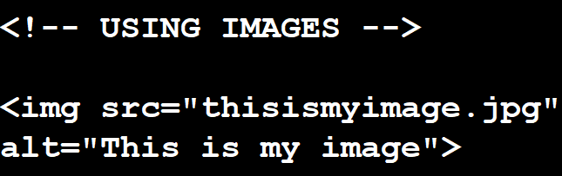
Using Images
<img src="IMAGE PATH" alt="YOUR ALTERNATIVE TEXT" style="width:width;height:height;">

Slide 12
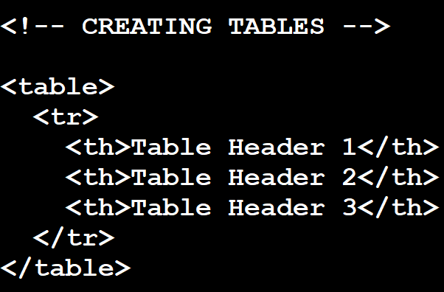
Creating Tables
OR <table style="width:100%">
<table>
<tr>
<th>Table Header 1</th>
<th>Table Header 2</th>
<th>Table Header 3</th>
</tr>
<tr>
<td>Input 1 under header 1</td>
<td>Input 1 under header 2</td>
<td>Input 1 under header 3</td>
</tr>
<tr>
<td>Input 2 under header 1</td>
<td>Input 2 under header 2</td>
<td>Input 2 under header 3</td>
</tr>
<tr>
<td>Input 3 under header 1</td>
<td>Input 3 under header 2</td>
<td>Input 3 under header 3</td>
</tr>
</table>

Slide 13
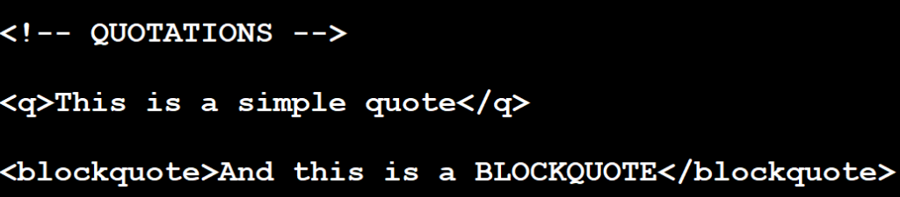
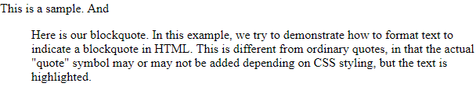
Quotations
<p>This is a sample. And <blockquote>Here is our blockquote. In this example, we try to demonstrate how to format text to indicate a blockquote in HTML. This is different from ordinary quotes, in that the actual "quote" symbol may or may not be added depending on CSS styling, but the text is highlighted.</blockquote></p>

